Slide 1

Electric Vehicle Investment and Regulation Will Help Connecticut Meet Its Climate Resiliency Goals
Dr. Emmanouil Anagnostou
Dr. Francesco Rouhana
Jan. 15, 2026

Slide 2
This presentation is arranged by the Connecticut Academy of Science and Engineering (CASE). This preliminary data provides informative insights; CASE can provide expert resources to produce appropriate studies and briefings.

Slide 3
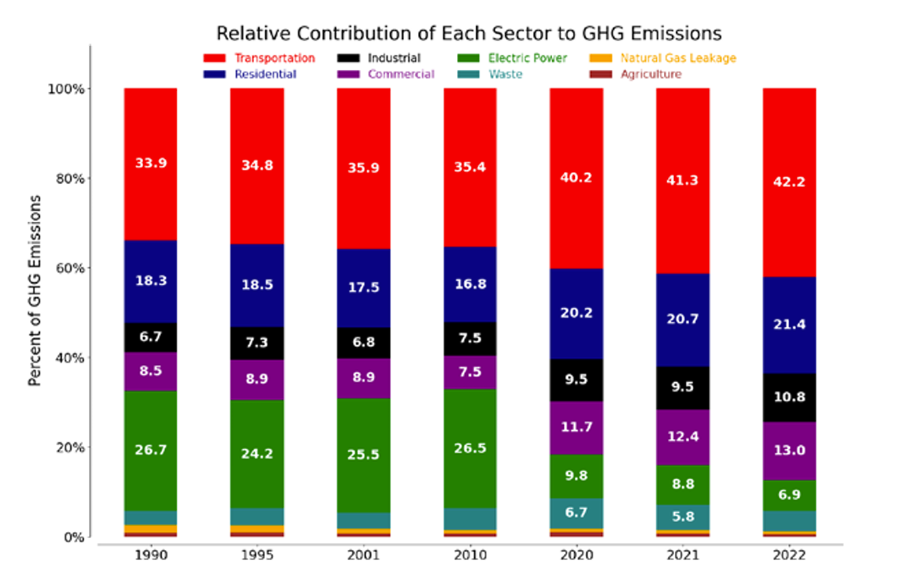
The policy “why now” for CT
Transportation is ~40% of Connecticut’s GHG emissions (largest sector)
CT’s statutory targets: 45% below 2001 emissions by 2030 and
      80% below 2001 emissions by 2050
      (Global Warming Solutions Act; PA 08-98, as amended by PA 18-82)
Percentage of total GHG emissions from various sectors (CTDEEP, 2024)
Meeting the 2030 target requires action this decade on vehicles + charging + operations (not just sales)
Electrification can be framed as clean transportation + grid reliability (heat waves, storms)

Slide 4
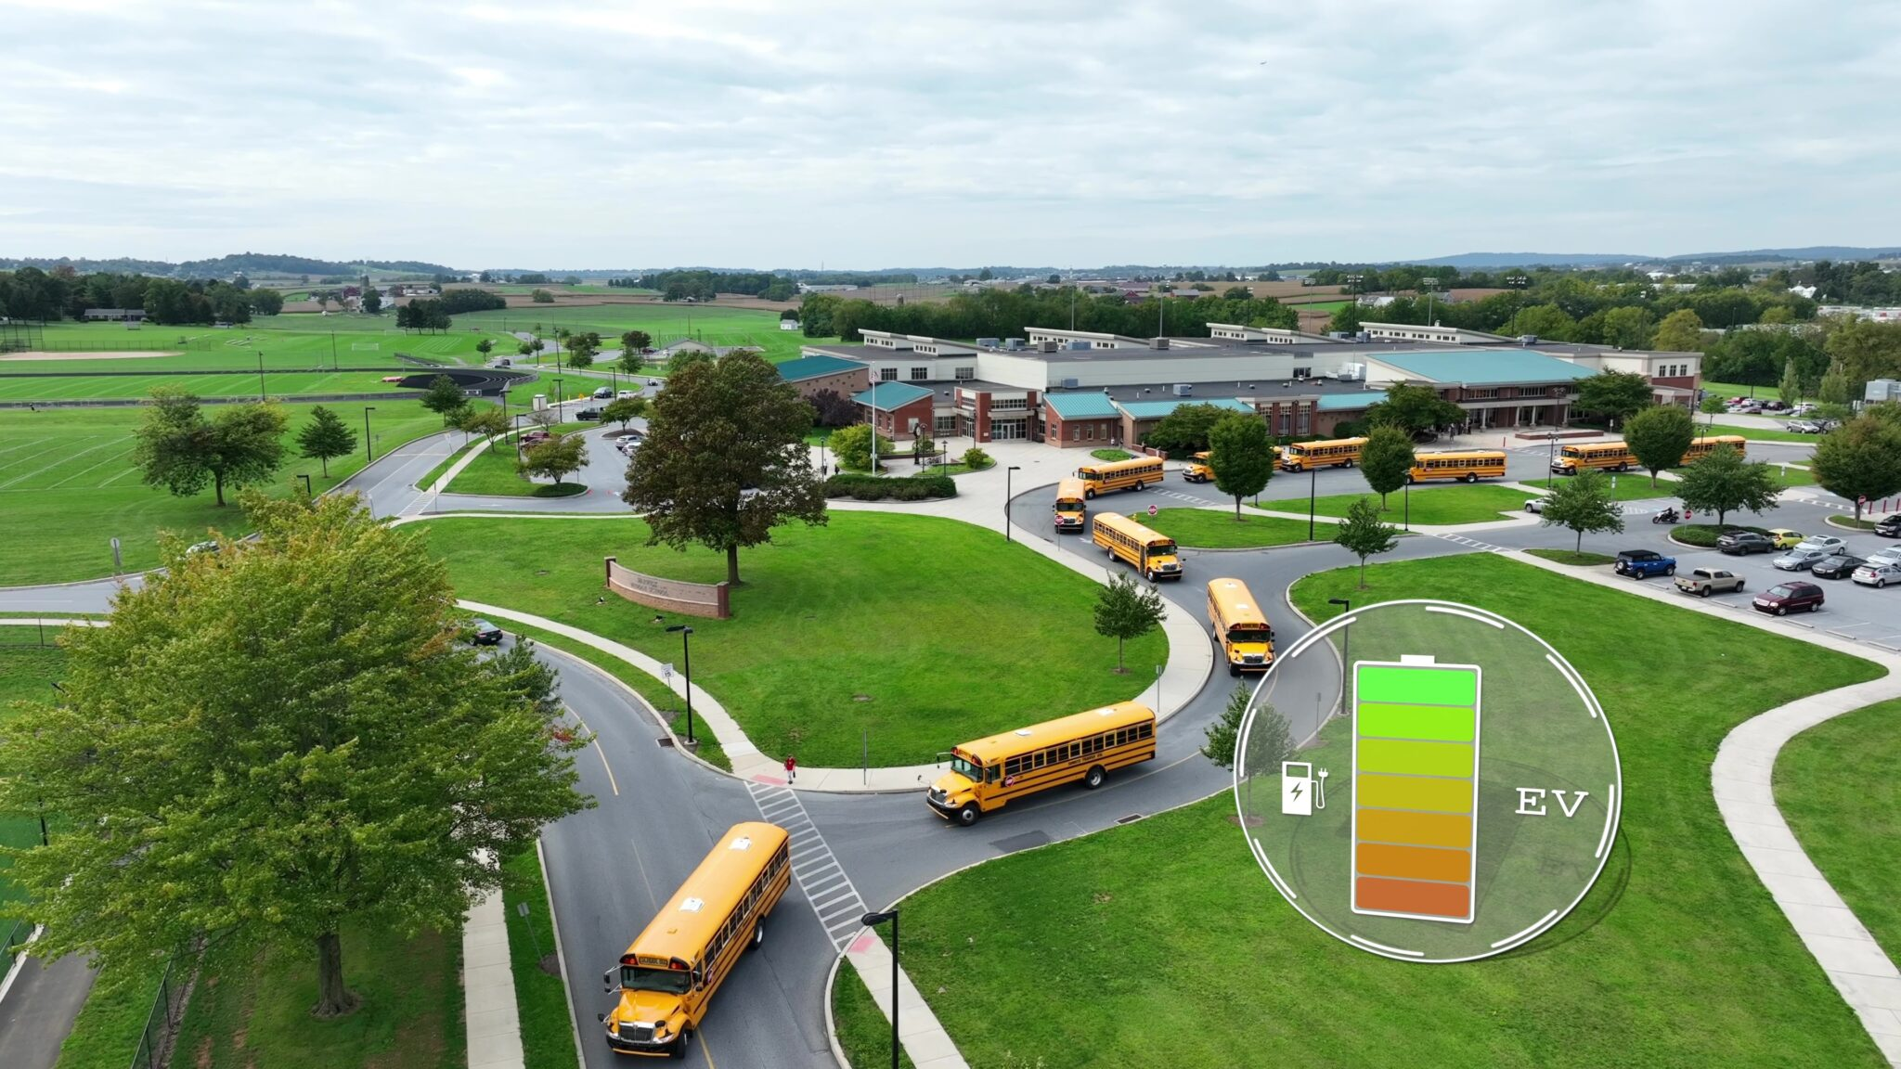
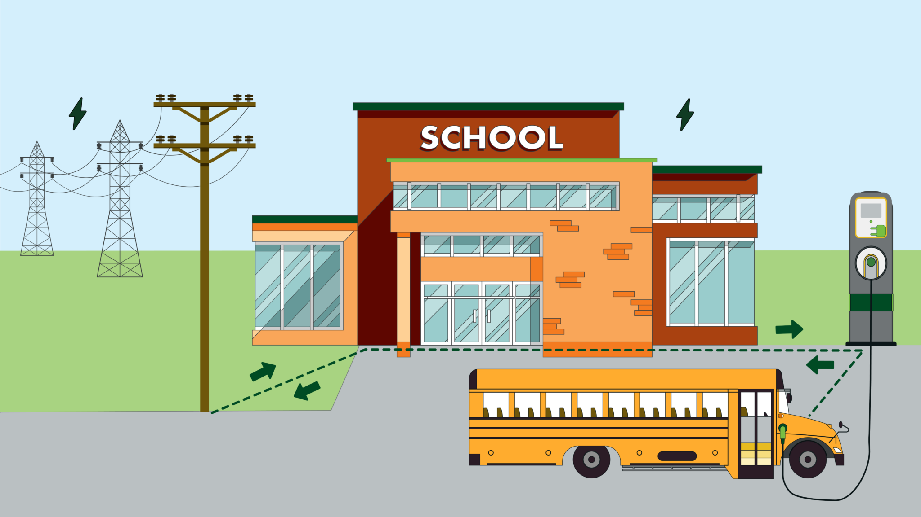
The opportunity: fleets & grid modernization
🚌 Fleet depots are “easy wins”
predictable schedules and centralized charging simplify managed charging + vehicle-to-grid (V2G)
⚡ Smart charging + savings
shifts load off-peak, eases feeder/substation stress, cuts fuel + maintenance costs
🔋 Resilience on demand
V2G supports local circuits during peaks, heat waves, and outages (~20% peak-shaving potential)
🌍 Equity & access
site V2G-ready depots in overburdened + rural areas to expand charging, cut local emissions, and strengthen circuit reliability
🌦️ Forecast-driven preparedness
pair depots with storm-outage forecasting + grid visibility to pre-stage buses and target backup power where risk is highest
www.mapc.org
www.mapc.org

Slide 5
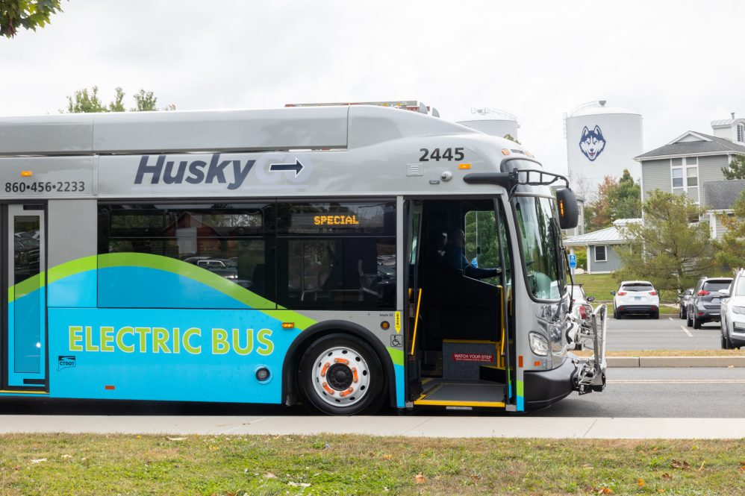
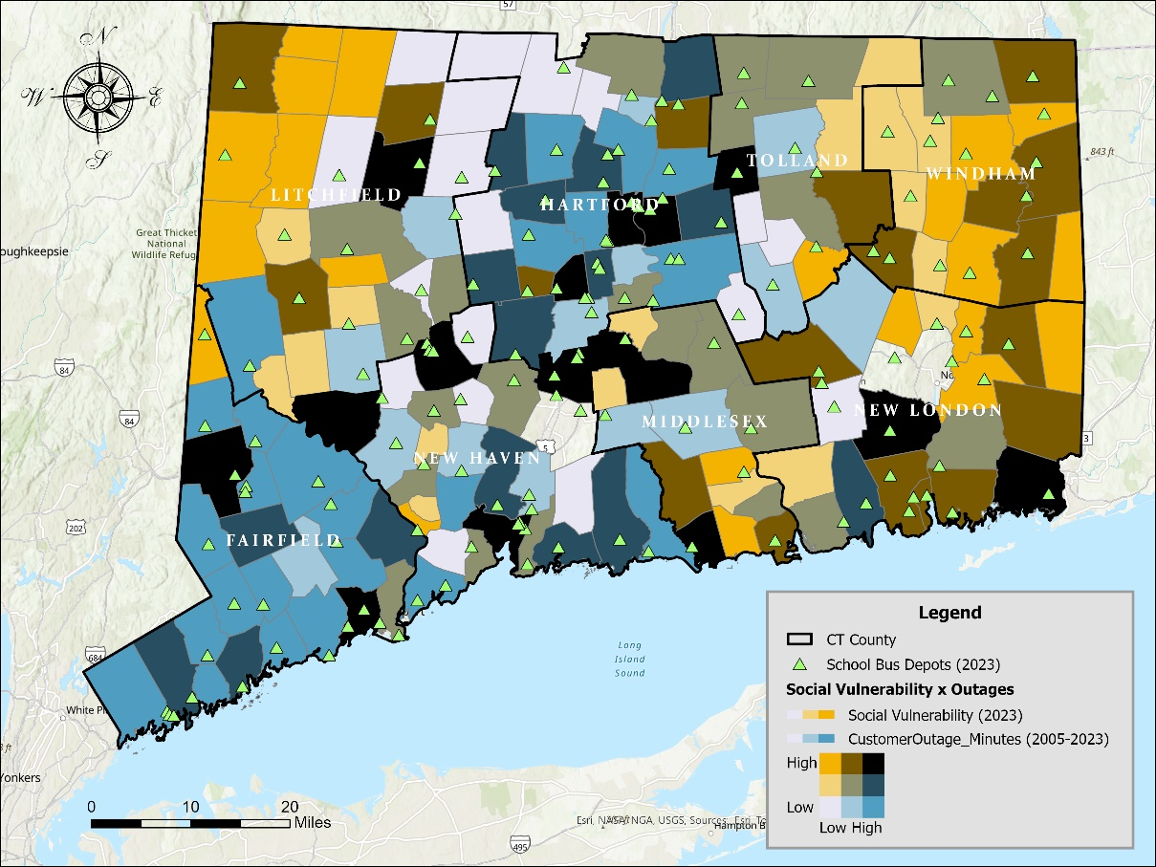
CT Momentum
Use federal dollars to accelerate bus depot upgrades/siting as resilience hubs
today.uconn.edu
Statewide scale: about 155 school bus depots and ~8,600 school buses in Connecticut.
Federal funding is already flowing to CT bus infrastructure:
(e.g., Windham Region Transit District bus facility…)
Prioritize sites that deliver co-benefits:
(Energy Justice/overburdened communities, critical facilities, high-ridership corridors…)
Pair depot investments with utility coordination:
(Hosting capacity, interconnection timelines, grid modernization and operational protocols…)
School Bus Depots, Social Vulnerability, and Historical Power Outages in Connecticut

Slide 6
Recommended actions that unlock fleet benefits
Policy levers
How CASE can help
Managed charging + time-of-use (TOU) rates
Time-limited V2G pilots + required reporting
Streamlined interconnection
Address demand-charge barriers
EV-ready upgrades for public facilities + multifamily charging sites
Equity- and resilience-based depot placement
Safety, cybersecurity, and interoperability standards for grid services
Independent cost–benefit analysis
Design managed-charging / TOU option
V2G pilot evaluation
Interconnection + code updates
Siting analytics
Program toolkit
CASE can help the State of Connecticut with independent review and analysis of V2G technologies, the impact of their deployment on communities and the environment, and on the cost of electricity.

Slide 7
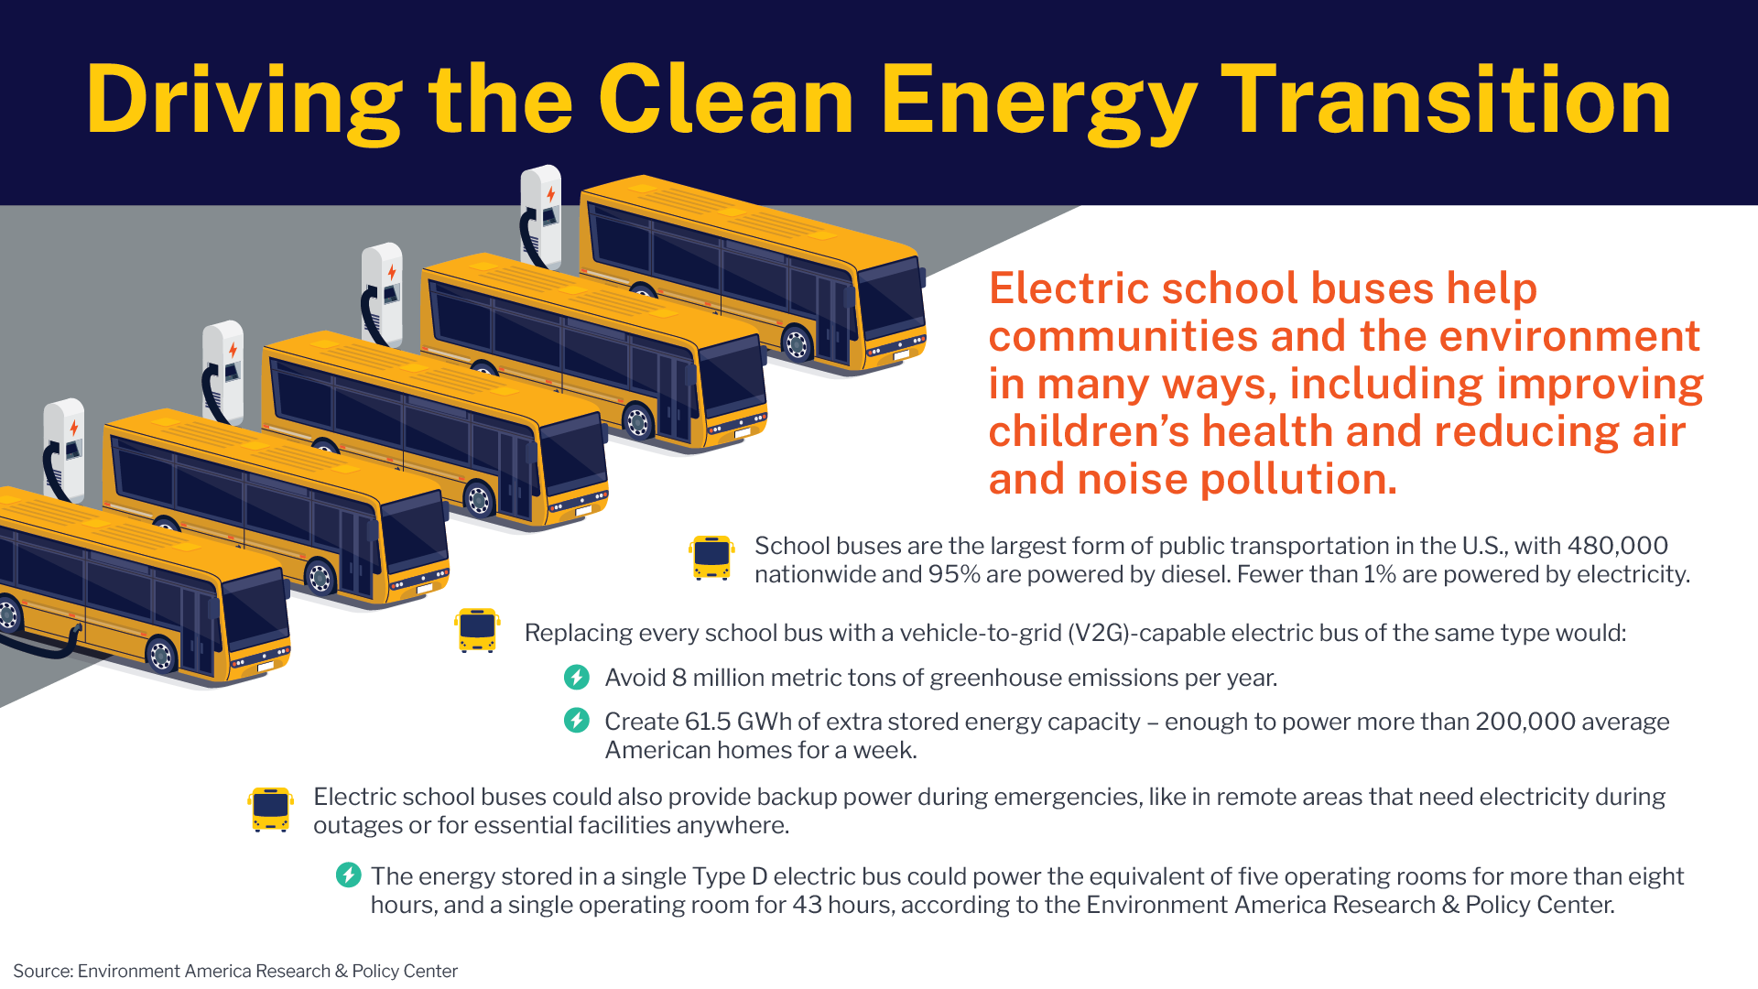
THANK YOU FOR YOUR ATTENTION!

