Slide 1




Connecticut Grid Resilience Assessment:
A Strategic Guide for Key Stakeholders
Brief submitted by
Dr. Emmanouil Anagnostou
Dr. Eleanor Shoreman-Ouimet
Dr. Francesco Rouhana
Andreas Prevezianos
Jan. 15, 2026
Presented by
Dr. Francesco Rouhana
Andreas Prevezianos

Slide 2





Introduction
2
Connecticut is expected to face more frequent severe storms and longer, costlier outages.
PURA mandates utilities align plans and projects with the Resilience Framework.
New funding/regulatory tools can prioritize the most vulnerable/high-exposure communities.
GRACI Guide (Grid Resilience Analysis and Climate Change Impacts):
Downscaled climate projections + historical outage records
Customer surveys + social vulnerability mapping
Infrastructure impact & restoration modeling
Distributed energy resources (DER) analysis
Delivers equity-focused guidance on where to invest for grid resilience

Slide 3
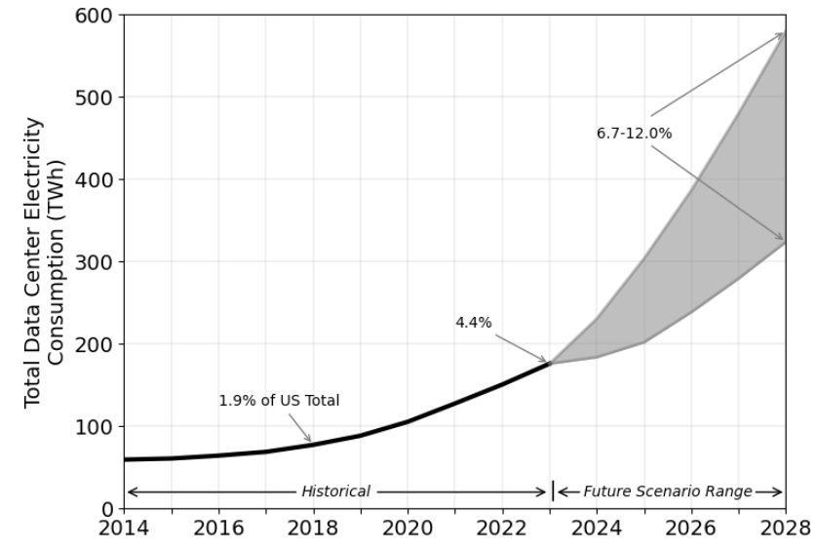
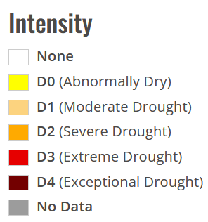
Study Results (1 out 5)
3
Projected increases in heat waves along the I-95 and I-91 corridors may stress urban power supply.
Given the high sensitivity of outages to high winds, more frequent extreme wind gusts may increase outage risk.
Climate trends + Rapid electrification (e.g., EV adoption and construction of AI-class facilities).
Requirements: Scalable infrastructure and strong safeguards
Eversource Energy
Lawrence Berkeley National Laboratory
U.S. Drought Monitor

Slide 4
Study Results (2 out 5)
Power outage hotspots
Climate projections → increase in frequency of rare events.
Climate-induced outage risk + areas already prone to outages.
Undergrounding of overhead powerlines
Vegetation management
Uniquely effective
Other (Pole replacement, etc.)
Risk increase
Tref = 50 yr
Risk decrease

Slide 5
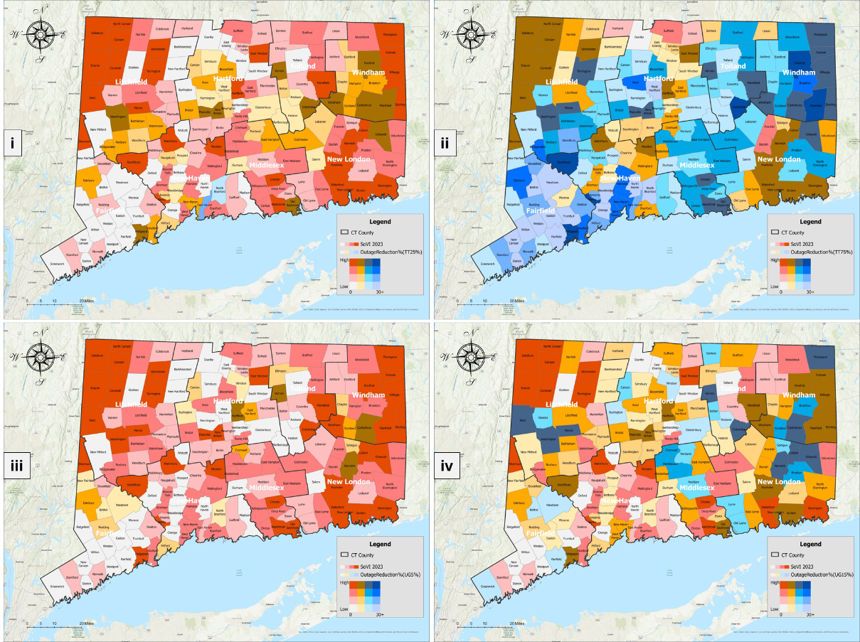
Study Results (3 out 5)
Eversource Energy
United
Illuminating
TT: 25%
TT: 75%
Large share of outages cannot be prevented.
Vegetation management → markedly effective.
A uniform application → reduces outage risk.
Large share of outages cannot be prevented.
Vegetation management → markedly effective.
A uniform application → reduces outage risk. .
Resource allocation efficiency
UG: 5%
UG: 15%
Requirement: Optimization

Slide 6



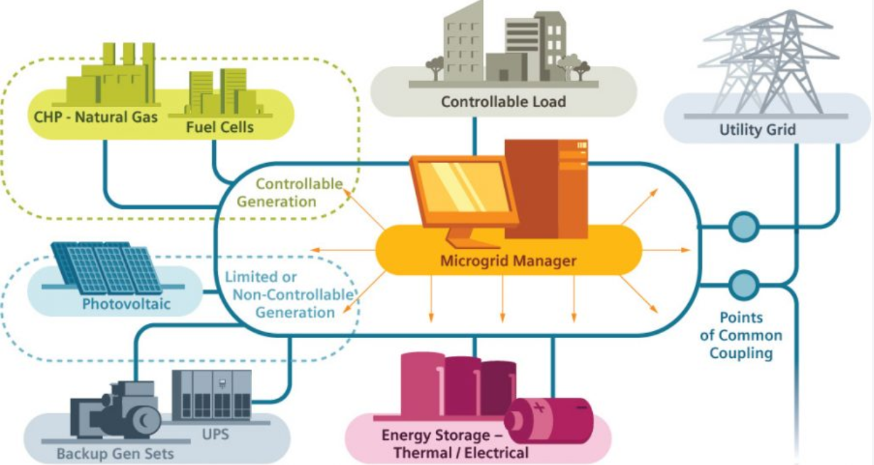
Study Results (4 out 5)
6
Grid hardening → Reduction of restoration labor costs
Strategic assignment of restoration crews → Reduction of outage hours
Most storm-related expenses (about 70%, per PURA)
Prioritization
Vulnerable communities
Major population centers
Slow recovery
Voltage instability
Peak load surges
Lack of Distributed Energy Resources (DERs) →
Compliance
PURA reporting metrics
DER-enabled circuits → Valuable benchmarks
The Center for Climate and Energy Solutions

Slide 7
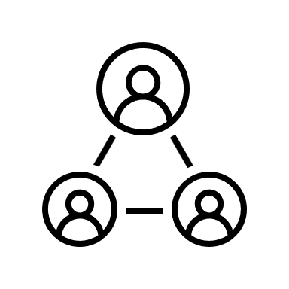
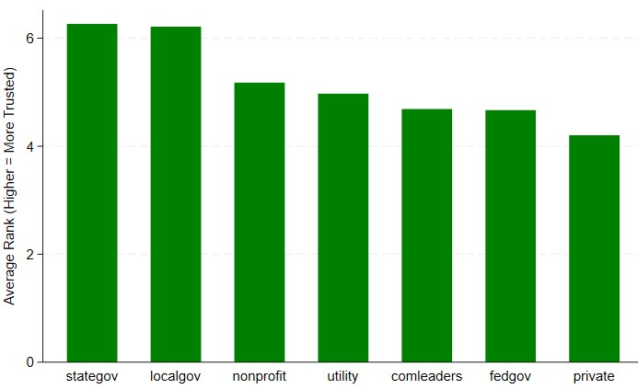

STUDY RESULTS
Study Results (5 out 5)
7
Heightened vulnerability
Limited coping capacity
Lower-income households
High-income households
Middle-income groups
High annual willingness to pay (WTP)
Productivity concerns
Stronger expectations for uninterrupted service
Existing preparedness measures
Balanced level of risk exposure
Lower - statistically insignificant WTP
Who should lead community engagement efforts?
Local and state officials

Slide 8











Strategies and Investment Priorities
Forecasting: statewide outage forecasting
Equity / Fairness: equity metrics
Filings / Grants: model-backed filings
Targeting: highest-risk circuits
Microgrids / Storage: adaptive microgrids
Crews / Logistics: crew pre-positioning
Metrics / Tracking: measure progress
Accountability: public accountability
Transparency / Audit: public reporting

Slide 9

THANK YOU
FOR YOUR ATTENTION!
To Read the Full Guide
SCAN ME

